Slide 1
My Father’s House John 2:12-25

Slide 2
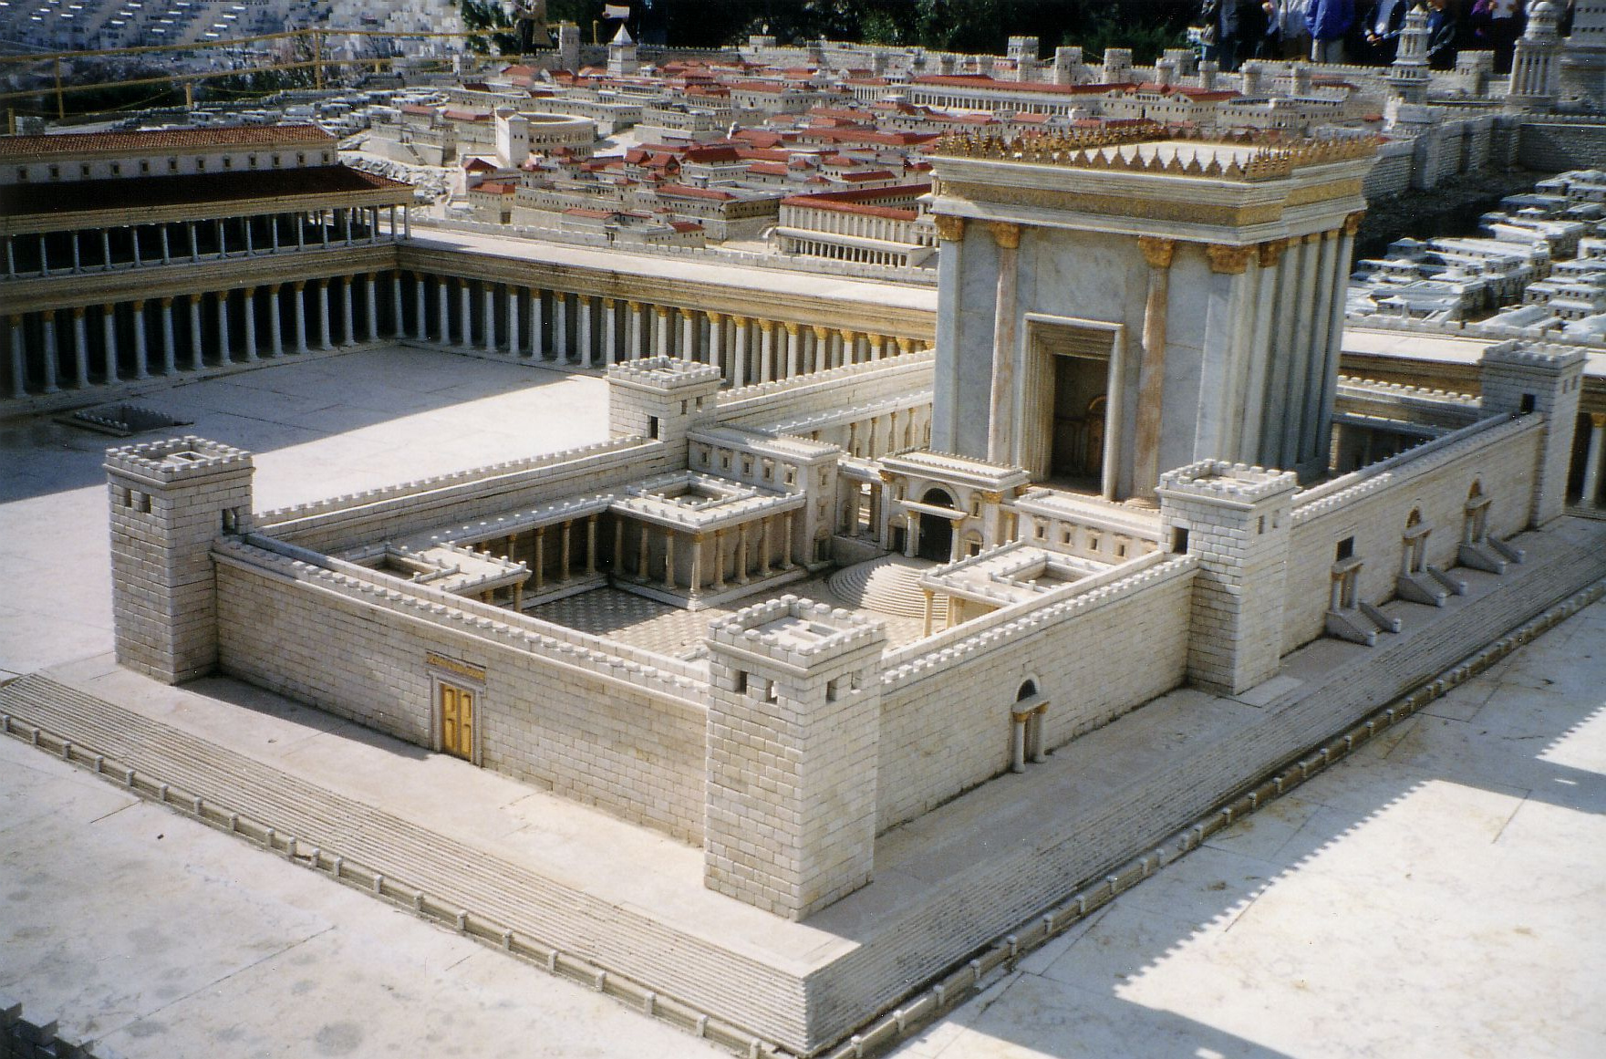
Herod’s Temple
Herod’s Temple (model reconstruction)

Slide 3
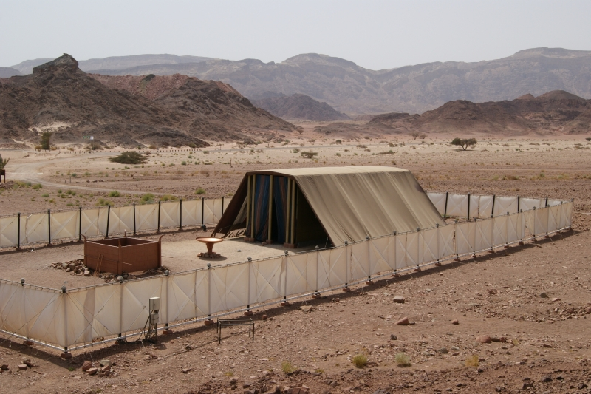
Tabernacle in the Desert

Slide 4
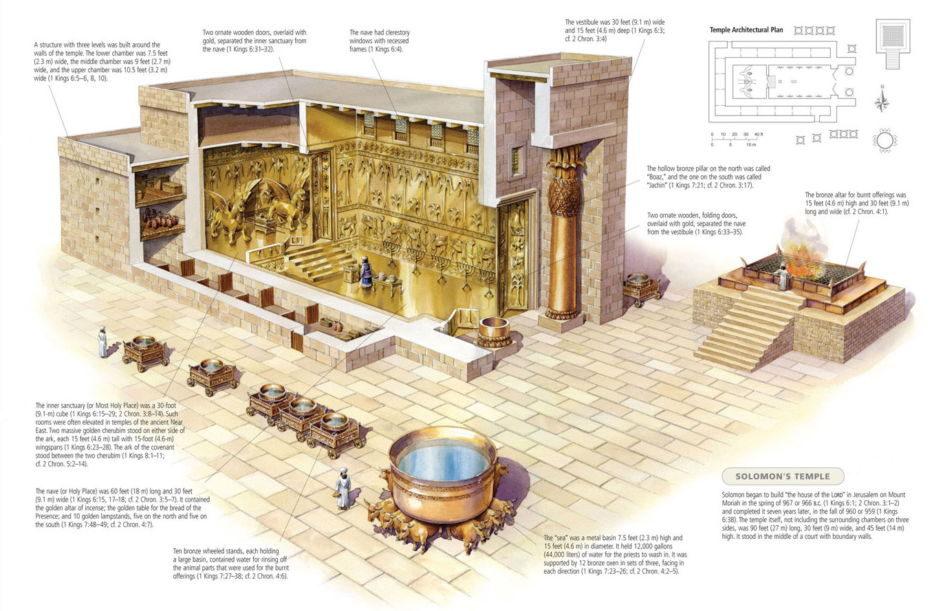
Solomon’s Temple cutaway

Slide 5
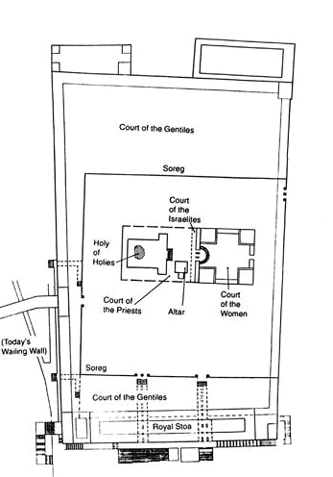
Herod’s Temple [plan view]

Slide 6
These are written that you may believe that Jesus is the Messiah, the Son of God, and that by believing you may have life in his name.
John 20:31

Slide 7
He “becomes the focal point of the manifestation of God to man, the living abode of God on earth, the fulfillment of all the temple meant, and the centre of all true worship.”
The Gospel According to John D.A. Carson

Slide 8
Hebrews 10
⁴ It is impossible for the blood of bulls and goats to take away sins…
¹¹ Day after day every priest stands and performs his religious duties; again and again he offers the same sacrifices, which can never take away sins. ¹² But when this priest had offered for all time one sacrifice for sins, he sat down at the right hand of God…
¹⁹ Therefore, brothers and sisters, [] we have confidence to enter the Most Holy Place by the blood of Jesus, ²⁰ by a new and living way opened for us through the curtain, that is, his body.

Slide 9
“No one has ever seen God, but the one and only Son, who is himself God and is in closest relationship with the Father, has made him known.”
John 1:18

Slide 10
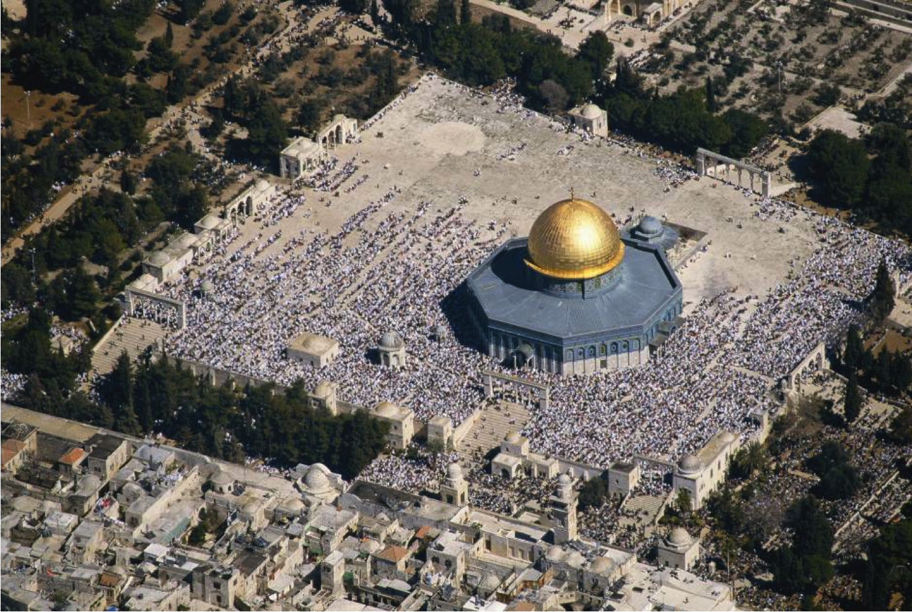
Dome of the Rock

Slide 11
I am the way and the truth and the life. No one comes to the father except through me. John.14:6
My sheep listen to my voice; I know them, and they follow me. I give them eternal life, and they shall never perish. John 10:27,28
Whoever comes to me I will never drive away. John 6:37
Whoever believes in the Son has eternal life. John.3:36
Apart from me you can do nothing. John.15:5

